Slide 1

RSpec Tutorial
By: Cleveland Endians (Cole Albers, David Sinchok, Andrew Fox, Adam Prater, Sam Yinger)

Slide 2
Overview
What is RSpec?:
construct unit tests for Ruby code
improved programming capabilities
quicker deployment of your application
agile developers + test driven development
Reduce the amount of errors and bugs in your code
By: Cole Albers

Slide 3
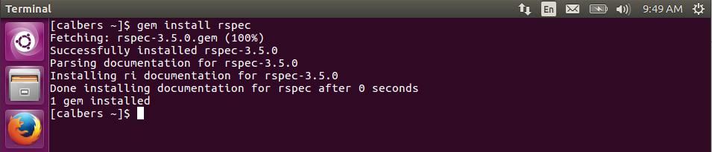
Introduction
Installation:
Dependencies
By: Cole Albers

Slide 4
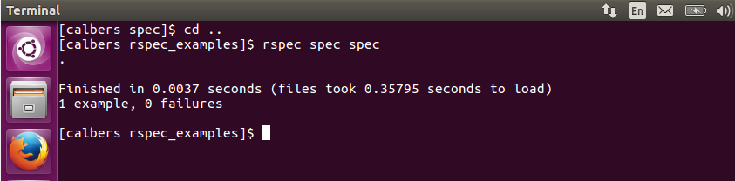
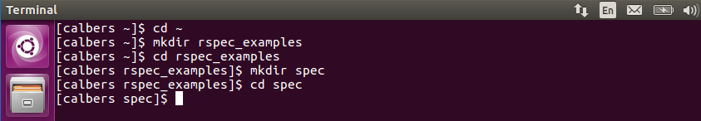
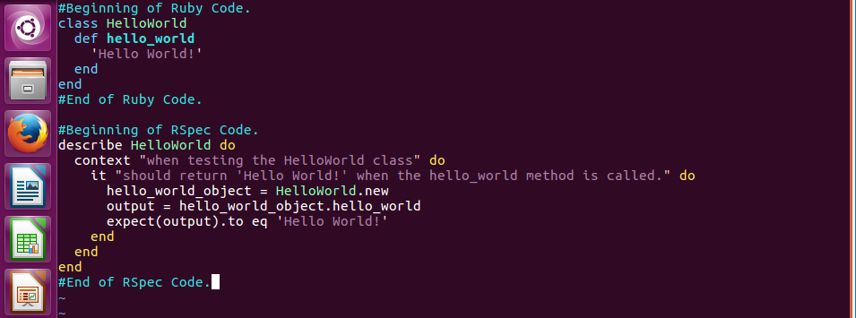
Introduction
Hello World!:
By: Cole Albers

Slide 5
Basic Syntax
Keyword – “describe”:
define a collection of test cases
“describe” == name of class/module being tested
By: Cole Albers

Slide 6
Basic Syntax
Keyword – “context”:
used to separate tests depending on their type
“context” == a string, describing the context of the test
examples: valid, invalid, boundary input
By: Cole Albers

Slide 7
Basic Syntax
Keyword – “it”:
used to define the specific test case
“it” == a string, describing the specific behavior, or expected outcome, of the test
By: Cole Albers

Slide 8
Basic Syntax
Keyword – “expect”, “to”, “eql”:
“expect” is used to define the expectation of the test case
“to” is used in combination with “expect” to reference what we are comparing our expectation to
“eql” is used in combination with “to” and “expect” to specify what kind of condition we are testing
By: Cole Albers

Slide 9
Basic Syntax
Conclusion: IT’S A STORY
By: Cole Albers

Slide 10
Writing Specs
DEMO
By: Cole Albers

Slide 11
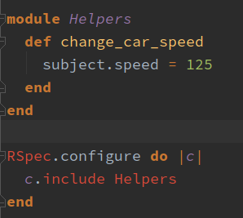
Helpers
Helper functions are common in application code
Allow for clean and reusable code segments
Can be used with RSpec
Include module in RSpec configuration
Simple declaration with describe block

Slide 12
Subjects
Code refactoring
Writing descriptive tests is important
Specification in Test Driven Development (TDD)
Allow for initializing an object or “subject” with describe keyword
describe Array.new, “Subject example with Arrays” do
//Tests here
end
Access within describe block
subject

Slide 13
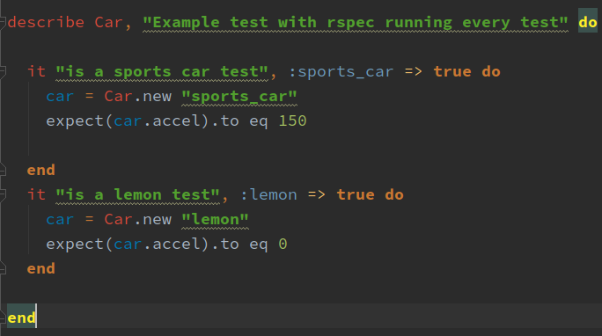
Subjects
Example without using subjects:

Slide 14
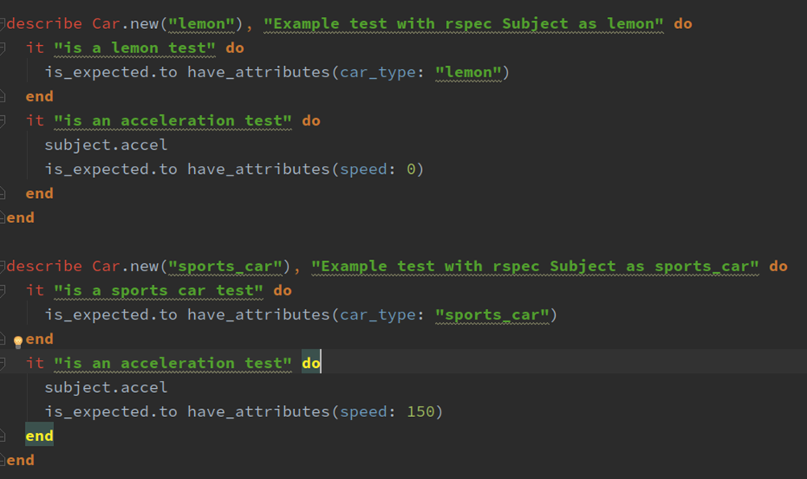
Subjects
Example with subjects:

Slide 15
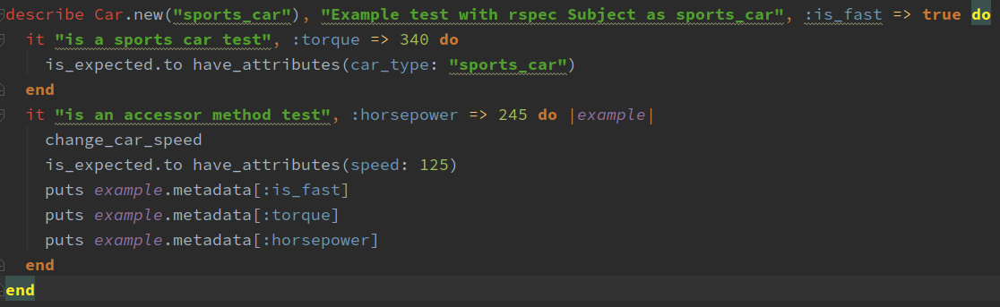
Metadata
What is metadata?
RSpec: Provides useful information about tests
Allows for scoped variables within tests

Slide 16
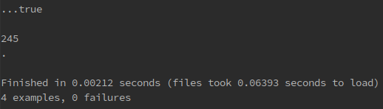
Metadata
Output:

Slide 17
Metadata
DEMO
By: Cole Albers

